Slide 1
对古希腊数学中的“分析方法”的历史考察
2015数学哲学学术讨论会 上海 2015年12月12-13日
郑方磊, 复旦大学历史学系
Notes:
Doctoral thesis
Language problem

Slide 2
报告提纲
绪言—古希腊数学史
Pappus对古希腊数学中的分析-综合方法的描述
前人关于关于pappus描述文字的争论
欧几里得《原本》命题的结构及定理与问题的两分
欧几里得《Data》及其命题的性质—变形与比较
“Data – Elements” ： “对问题的分析与综合”
“分析-综合”见于存世古希腊数学问题的命题实例
结论

Slide 3
绪言 -- 古希腊数学史
Notes:
My introduction about the life of the works of Jordanus Nemorarius is based on professor Hoyrup’s comprehensive research on Jordanus.

Slide 4
Pappus （公元四世纪，《数学全集》第七卷） 对古希腊数学中的分析-综合方法的描述
“分析领域”的存在、目的与方法
对分析方法与综合方法的一般描述
对“对定理的分析”与“对问题的分析”的分别描述
古希腊数学中属于“分析领域”的若干作品
Notes:
These works listed on the slide are believed to be genuine of Jordanus. The titles indicate that they concern Arithemtics, Geometry, Astronomy, and Statics. For four of them, we already have critical editions, the authors and the years of publication of which are noted between the pa‘rentheses

Slide 5
（Alexander Jones 译文，Springer-Verlag, 1986）
Notes:
Alexandre Jones

Slide 6
（Alexander Jones 译文）
Notes:
Alexandre Jones

Slide 7
前人关于Pappus分析方法的争论
如果命题的结论为(5)，那么
观点1：
分析：(5)→ (4)→ (3)→ (2)→ (1)， (1)成立/为真/已得…
综合：(1)→ (2)→ (3)→(4)→ (5)
观点2
分析：(5)← (4) ← (3) ← (2) ← (1)， (1)成立/为真/已得…
综合：(1)→ (2)→ (3)→ (4)→ (5)
观点3
分析：(5) → ← (4) → ← (3) → ← (2) → ← (1)， (1)成立/为真/已得…
综合：(1)→ (2)→ (3)→ (4)→ (5)
Notes:
These works listed on the slide are believed to be genuine of Jordanus. The titles indicate that they concern Arithemtics, Geometry, Astronomy, and Statics. For four of them, we already have critical editions, the authors and the years of publication of which are noted between the pa‘rentheses

Slide 8
欧几里得《原本》命题的结构
Proclus《对欧几里得〈原本〉第一卷的注释》
（公元五世纪）
Mais tout problème et tout théorème, remplis de leurs parties accomplissantes, doivent posséder en propre toutes celles-ci : la proposition, l'exposition, la détermination, la construction, la démonstration et la conclusion. Parmi ces parties, la proposition, après avoir donné une certaine chose, déclare quel est l'objet de la recherche; car une proposition parfaite comporte ces deux choses. L'exposition, reprenant en particulier cette chose donnée, la dispose d'avance en vue de ce qui est cherché. La détermination explique clairement à part ce qui constitue la chose cherchée. La construction ajoute ce qui manque à la chose donnée en vue de poursuivre ce qui est cherché. La démonstration induit savamment la proposition par suite des choses consenties. Enfin, la conclusion retourne de nouveau à la proposition en confirmant ce qui a été démontré. Telles sont donc les parties des problèmes et des théorèmes.
Notes:
These works listed on the slide are believed to be genuine of Jordanus. The titles indicate that they concern Arithemtics, Geometry, Astronomy, and Statics. For four of them, we already have critical editions, the authors and the years of publication of which are noted between the pa‘rentheses

Slide 9
Notes:
These works listed on the slide are believed to be genuine of Jordanus. The titles indicate that they concern Arithemtics, Geometry, Astronomy, and Statics. For four of them, we already have critical editions, the authors and the years of publication of which are noted between the pa‘rentheses

Slide 10
Notes:
These works listed on the slide are believed to be genuine of Jordanus. The titles indicate that they concern Arithemtics, Geometry, Astronomy, and Statics. For four of them, we already have critical editions, the authors and the years of publication of which are noted between the pa‘rentheses

Slide 11
欧几里得《原本》 命题的结构及定理和问题的两分（粗）
Proclus的结构划分 | 定理 | 问题
Protasis | 命题的陈述 | 命题的陈述
Ekthesis | 令（设若） … | 令（设若） …
Diorismos | 我说 … | 那么，要求作…
Kataskeue | 该部分可能没有 | 该部分一定有
? |  | 我说 …
Apodeixis | 因为 … | 因为 …
Sumperasma | 因此 Q. E. D | 因此 Q. E. F
Notes:
These works listed on the slide are believed to be genuine of Jordanus. The titles indicate that they concern Arithemtics, Geometry, Astronomy, and Statics. For four of them, we already have critical editions, the authors and the years of publication of which are noted between the pa‘rentheses

Slide 12
The dichotomy between theorem and problem in the Elements of Euclid
Proclus’ partition for a proposition | Function of the parts | Theorem | Problem
Protasis | Enunciation | If …, (then)….. | Given …, to …..
Ekthesis | Instantiation of the presupposes | Let … be …. | Let … be … given …
Diorismos | Instantiation of the aim of research | I say that … | It is required to …
Kataskeue | Construction | may be absent | never absent
? | Second instantiation of the aim of research | always absent | I say that …
Apodeixis | Proof | For, … | For, …
Sumperasma | Conclusion | Therefore, … Q. E. D | Therefore, …. Q. E. F

Slide 13
欧几里得《原本》中定理与问题的两分（细）

Slide 14
The dichotomy between theorem and problem in the Elements of Euclid

Slide 15
The dichotomy between theorem and problem in the Elements of Euclid

Slide 16
欧几里得《Data》
“分析领域”作品之首（根据Pappus）
欧几里得仅有的两部存世作品之一
若干定义加略多于100个命题
对《Data》的争议
“简单的几何练习”
“蕴藏着古希腊数学研究的真正方法”
希腊文Dedomena/dothen
拉丁文data
英文given
中文 -- ”给定“？
Notes:
These works listed on the slide are believed to be genuine of Jordanus. The titles indicate that they concern Arithemtics, Geometry, Astronomy, and Statics. For four of them, we already have critical editions, the authors and the years of publication of which are noted between the pa‘rentheses

Slide 17
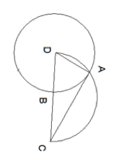
欧几里得《Data》第90命题
Dt.90 : If from a given point a straight line be drawn tangent to a circle given in position, the straight line drawn will be given in position and in magnitude.
For, from the given point C let the straight line CA have been drawn tangent to the circle AB given in position [III. 17]; I say that the straight line CA is given in position and in magnitude.
For, let the centre D of the circle have been taken, and let DA, DC have been joined. Since each of D, C is given, therefore [the line] DC is given [Dt 26]. And DAC is right [III. 18]; therefore the semicircle described on DC will pass through A [III. 31]
Let it have passed, and let it be the [semicircle] DAC; then DAC is given in position [Def. 8]. And the circle AB is also given in position; therefore the [point] A is given [Dt 25]. But C is also given; therefore AC is given in position and in magnitude [Dt 26].
Notes:
Taisbak

Slide 19
《Data》的命题是什么？ 希思如是说
… It is to be observed that this form of proposition does not actually determine the thing or relation which is shown to be given, but merely proves that it can be determined when once the facts stated in the hypothesis are known; if the proposition stated that a certain thing is so and so, e.g. that a certain straight line in the figure is of a certain length, it would be a theorem ; if it directed us to find the thing instead of proving that it is 'given', it would be a problem; hence many propositions of the form of the Data could alternatively be stated in the form of theorems or problems.
We should naturally expect much of the subject-matter of the Elements to appear again in the Data under the different aspect proper to that book; and this proves to be the case …

Slide 20
Data第九十命题，若以《原本》之命题的方式书写
From a given point to draw a straight line tangent to a given circle.
Let C be the given point, and BEF the given circle. It is required to draw a straight line from the point C touching the circle BEF.
Let the center D of the circle be taken, and let DC be joined. Let the semicircle DAC described on the diameter DC, and let it be cutting with the circle BEF at the point A. Let the straight line AC be joined, and let DA be joined.
I say that AC touches the circle EFG. For, since DAC is the angle in the semicircle, DAC is a right angle. So the straight line AC is drawn at right angles to the diameter of the circle BEF from its end the point A, therefore CA touches the circle BEF at A.
Therefore, from the given point C, the straight line CA is drawn tangent to the given circle BEF. Q. E. F.

Slide 21
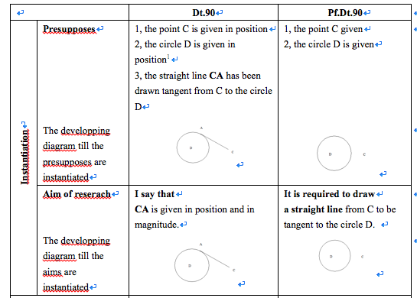
比较Data第90命题与以《原本》方式改写的命题

Slide 22
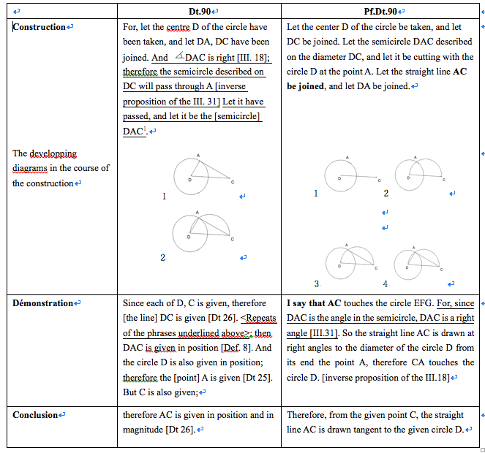
Compare the Data.90 and the frabricated problem

Slide 23
Apollonius《圆锥曲线》中的关键字句
N° | 问题的要求 | 分析的起点 | 分析的结论 | 综合的起点
II.44 | 求作直径 | 假定直径已经获得 | … TZG will be given | 因此综合如下
II.46 | 求作轴线 | 假定问题已经解决，假定其为GD | GD will be given in position | 因此综合如下
II.47 | 求作轴线 | 假定问题已经解决，假定其为KD | DK will be given in position | 因此综合如下

Slide 24
Apollonius《圆锥曲线》卷二第44命题

Slide 25
Notes:
II, 46; II, 49; II, 50

Slide 26
结论 -- 几点推进
回答了为什么欧几里得Data别列为分析领域之首
显示了现存带有分析部分的古希腊数学命题其类型都是“问题”
对古希腊“问题分析”的方法及其与“综合”的关系作出了细致的“规范性”的描述
再一次确证了对古代数学方法的研究不能仅关注对相关方法一般描述的古代证据
提供了古典语言文字学和现代数学的角度以外的“实践角度”和“实验方法”
Notes:
My introduction about the life of the works of Jordanus Nemorarius is based on professor Hoyrup’s comprehensive research on Jordanus.

